Slide 1
Cga1121/ega1121/mga1121 – DATA STRUCTURES
Academic Year: 2023 – 2024
I Year / II Semester
Register Number : 927623BCS011
Name : M S ARUN SANJEEV
Department : Computer Science & Engineering

Slide 2
Title of the Project
TO – DO LIST APPLICATION

Slide 3
Abstract
The "To-Do List Application" project, developed using the C programming language, aims to create a simple, efficient, and user-friendly solution for managing daily tasks. This application addresses common productivity challenges by allowing users to create, update, delete, and view tasks systematically. Built with robust data structures such as linked lists, hash maps, and stacks/queues, the application ensures optimal performance and usability.

Slide 4
Abstract with CO/PO Mapping
Abstract | CO | POs | PSO
The "To-Do List Application" project, developed using the C programming language, aims to create a simple, efficient, and user-friendly solution for managing daily tasks. This application addresses common productivity challenges by allowing users to create, update, delete, and view tasks systematically. Built with robust data structures such as linked lists, hash maps, and stacks/queues, the application ensures optimal performance and usability. | s | PO1(2) PO2(3) PO3(2) PO4(2) PO5(3) PO6(1) PO7(3) PO8(2) PO9(3) PO10(3) PO11(2) PO12(2) | PSO1(3) PSO2(2)

Slide 5
Introduction
The "To-Do List Application" is a project aimed at developing an efficient and user-friendly task management tool using the C programming language. In today's fast-paced environment, managing tasks efficiently is crucial to maintaining productivity and meeting deadlines. Many people face challenges in organizing their daily activities, leading to inefficiencies and missed commitments. This application seeks to address these issues by providing a digital solution that allows users to easily create, manage, and track their tasks.

Slide 6
Data Structure Used
The Data Structures Used in To-Do List Application are
Linked List
Stack (Last In First Out)
Queue (First In Last Out)

Slide 7
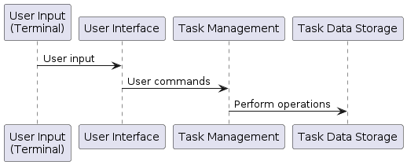
Proposed Architecture

Slide 8
Proposed Architecture - Description
The To-Do list application will be designed using a modular architecture, consisting of several interconnected components.
The to-do list project in C offers a minimalist terminal-based interface for task management. Users interact with a menu-driven interface to add, delete, and list tasks. Task data is stored locally within the program's memory.
These components will handle tasks such as user input, task management, storage, and user interface.

Slide 9
Proposed Architecture - Description
Add Task: The UI sends task details to TaskManager, which inserts the task into a LinkedList and confirms the insertion. TaskManager then enqueues the add task action and notifies the UI of the successful addition.
Delete Task: The UI requests TaskManager to delete a task by its ID. TaskManager removes the task from the LinkedList, confirms the removal, enqueues the delete task action, and notifies the UI.
Undo Action: The UI requests TaskManager to undo the last action. TaskManager dequeues the last action from the Queue, performs the undo operation on the LinkedList, and confirms the action's reversal to the UI. The User interacts with the UI to add, delete, and undo tasks.

Slide 10
List of Modules
User Interface: Responsible for interacting with the user and displaying task information.
Task Manager: Manages tasks, including creation, editing, prioritization, and completion.
Storage: Handles persistent storage of tasks using LINKED LIST,QUEUE,STACK CONCEPT , allowing users to access their tasks across sessions.

Slide 11
Module Description
User Interface Module: This module is responsible for facilitating user interaction and displaying task information. It provides an intuitive interface for users to interact with the To-Do List application.
Task Manager Module: This module handles various task-related functionalities such as task creation, editing, prioritization, and marking tasks as completed. It ensures efficient management of tasks within the To-Do List application

Slide 12
Module Description
Storage Module (Linked List): Implements persistent storage of tasks using the Linked List data structure. Tasks are stored in a dynamic manner, allowing for easy access and manipulation. This module ensures seamless retrieval and storage of tasks across different sessions of the application.
Storage Module (Queue): Utilizes the Queue data structure for managing tasks in a First-In-First-Out (FIFO) manner. This ensures that tasks are processed and retrieved in the order they were added, maintaining chronological integrity within the To-Do List application.
Storage Module (Stack): Implements task storage using the Stack data structure, facilitating Last-In-First-Out (LIFO) task retrieval. This module enables efficient handling of task operations such as undo functionality or prioritizing recently added tasks within the To-Do List application.

Slide 13
Module Description
Storage Module (Linked List): Implements persistent storage of tasks using the Linked List data structure. Tasks are stored in a dynamic manner, allowing for easy access and manipulation. This module ensures seamless retrieval and storage of tasks across different sessions of the application.
Storage Module (Queue): Utilizes the Queue data structure for managing tasks in a First-In-First-Out (FIFO) manner. This ensures that tasks are processed and retrieved in the order they were added, maintaining chronological integrity within the To-Do List application.
Storage Module (Stack): Implements task storage using the Stack data structure, facilitating Last-In-First-Out (LIFO) task retrieval. This module enables efficient handling of task operations such as undo functionality or prioritizing recently added tasks within the To-Do List application.

Slide 14
Module Description
Task Creation: Allows users to create new tasks through the User Interface module. Task Manager handles the process of adding tasks to the storage, ensuring seamless integration of new tasks into the To-Do List application.
Task Completion: Allows users to mark tasks as completed through the User Interface module. The Task Manager module updates the task status in the storage, maintaining an accurate representation of completed tasks within the To-Do List application.

Slide 15
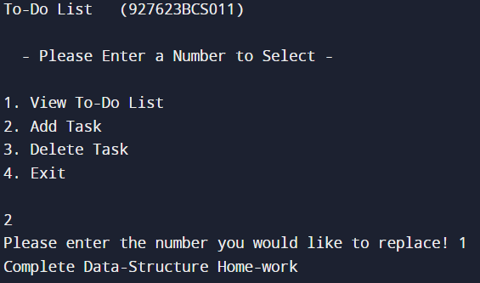
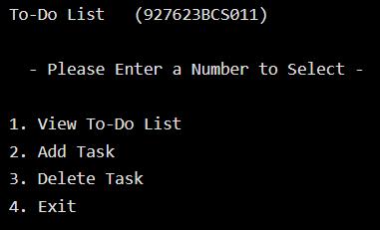
Results and Discussion
RESULTS
2. Add To Do List:
1. User Interface Menu:

Slide 16
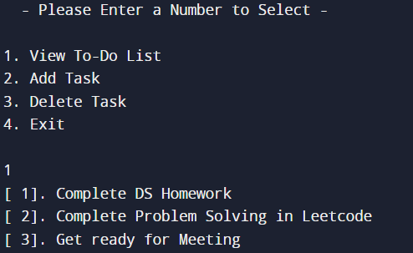
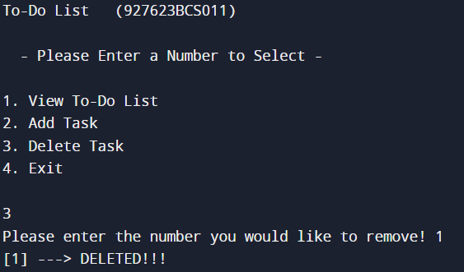
Results and Discussion(Cont..)
3.View To-Do List
4.Delete Task:

Slide 17
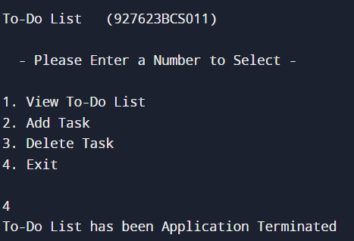
Results and Discussion(Cont..)
5.Exit:

Slide 18
Results and Discussion(Cont..)
DISCUSSION
Effective task management is crucial for personal productivity and goal achievement. By organizing tasks systematically, individuals can prioritize their activities, reduce stress, and improve time management skills. However, traditional methods of task management, such as pen and paper lists, are often cumbersome and lack features for efficient organization and tracking.

Slide 19
Conclusion
In conclusion, the "To-Do List Application" stands as a robust solution for modern task management challenges, offering users a streamlined and intuitive platform to organize and prioritize their activities effectively. Through its userfriendly interface and customizable features, the application caters to diverse user needs, empowering individuals to take control of their tasks and optimize their productivity. By leveraging modular design principles and efficient data structures, the application ensures scalability, maintainability, and optimal performance.

Slide 20
REFERENCES
1. Trello. (n.d.). Retrieved from https://trello.com/ Trello
is a popular project management tool that offers to-do list functionality among its features. Exploring Trello's interface and user experience can provide valuable insights into effective design and functionality for to-do list applications.
2.Todoist. (n.d.). Retrieved from https://todoist.com/ Todoist
is another widely used to-do list application that offers a range of features for task management and organization. Analyzing Todoist's features and user experience can offer inspiration and ideas for designing and implementing similar functionalities in your own to-do list application.

Slide 21
Thank You
Any queries???

